Slide 1


Copyright and Usage
This document was created by faculty of the Mobile Application Development Program within the Information and Computing Studies department of the National Technical Institute for the Deaf (a college of the Rochester Institute of Technology) as part of a grant from the National Science Foundation (NSF).
The document is copyrighted. It is licensed for public use with some restrictions under a Creative Commons license.
Restrictions for the use of this document include:
All references to this work must be fully attributed
No part of this work can be used commercially
No derivative variants of this work may be distributed
For more information, please click on the link below.

Slide 2
Variables & Statements
A brief introduction to variables, data types, and how C# uses them

Slide 3
A Few Things Before We Get Started
With Console Applications, code is placed inside a code block called Main
static void Main(string [] args)
When you start a console program, .Net Core looks for a block of instructions named Main
The instructions in Main automatically begin executing
Main resides inside another set of curly braces
It’s a class called Program
A class is a container of all code in your program (oversimplification)
Curly brackets and parentheses always come in pairs
These mark the start and end of something

Slide 4
Fundamental Language Elements
Curly Brackets - always in pairs! Parenthesis, too!
namespace MyFirstProgram
{
class Program
{
static void Main(string[] args)
{
Console.WriteLine(“Hello World!”); Console.ReadLine();
}
}
}
Notes:
Reserved words, sometimes called keywords, in any programming language, are those written entities contained within a program that the specific language uses to control its behavior. They can only be used for the specific purpose they were intended to perform. They cannot be used out of their intended sequence in any context. If the programmer tries to do this the compiler will fail with an error indicating the incorrect usage of the reserved word.
Look at Appendix D. Look at a couple. Note that goto and const are reserved but are currently not part of the language. In programming goto is a bad word. explain
Identifiers, on the other hand, are those written entities contained within a program that the user chooses to name the constructs he/she decides to use to create the logical flow of the program. They represent either variables or method names that the user creates. “Magic values” are hard-coded (without identifiers) items within a program and are discouraged from use in this course. Any hard-coded value can be assigned to a variable with an appropriate identifier!
All grouped constructs in Java are delimited (separated) using pairs of curly braces. The coding standard shows the preferred method of positioning these “brace-pairs” in the code. Forgetting them, or using a left without a matching right brace (or vice-versa), will cause a compiler error.

Slide 5
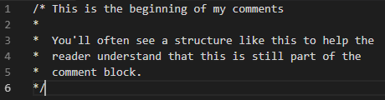
Comments
Entirely for human readers; ignored by the compiler.
Two ways to comment in C#.
// A single line (inline) comment.
/* The text of a multi-line comment may be spread over several lines. */
Read Chapter 4 in The C# Player’s Guide for more information about comments
You might see multi-line comments
formatted like this

Slide 6
The World Of Coding
Half of learning code is the syntax of a programming language, in this case, C#
Syntax involves nouns, verbs, punctuations, etc.
The other half is learning about the pre-built functionality of programming
Such as Write() and WriteLine()
Pre-built functionality comes from the .NET Core

Slide 7
.NET Core
.Net Core is (in a word): HUGE
Class Library
Created by Microsoft
Many of these take care of difficult tasks
Why? So we don’t have to tackle these difficult tasks
Examples: Working with Strings, Math, DateTime, transmitting data across a network, etc.
You’ll learn more about these later
You’ll learn about various class libraries in .Net Core throughout this course

Slide 8
.Net Core – The CLR
CLR is an acronym for the Common Language Runtime
Your application runs inside the CLR
CLR takes care of the low-level details you don’t need to worry about
Operating Systems, hardware, etc.
Focus on building the car (doors, windows, etc.) and don’t worry about the engine
Provides a special protection layer for end users

Slide 9

Definition Of “Variable”
Definition from Oxford Dictionaries:
Adjective
not consistent or having a fixed pattern; liable to change
able to be changed or adapted
Noun
an element, feature, or factor that is liable to vary or change
Note the word that appears in every definition: change
In programming, a variable is a place in memory to store information
Think of it as a bucket or box to put something in
When the program runs, what’s “in the bucket” may change or stay the same

Slide 10
This is really important!
On the previous slide, we said:
“In programming, a variable is a place in memory to store information” and to think of it like a bucket to put stuff in
Here’s the important part: The variable (bucket) can hold one (and only one) value!!!!
For example, your age, your cell phone number, etc.
It cannot hold both your first name and age

Slide 11

Variables: Names
We need to create a name for each piece of information (data) we want to work with
Each variable in C# has a unique name
The name of the variable allows you to access the specific data associated with that variable
You can have 1,000 variables and each would have its own unique name
Names should be easily identifiable; not arbitrary
Names should clearly indicate what data is being stored there
For example, studentTuitionBalance is more clear than owesTheCollege
Which bucket did I store the first name in?

Slide 12
Variables: Names – II
Use (lower) camel casing for names
One or more words with no space
First word is in lowercase format
Remaining word element begins with uppercase letter
Examples:
school
myFirstCar
thisIsAReallyLongVariableName
Which bucket did I store the first name in?

Slide 13

Variables: Types
For each variable, you need to decide which type of information you want to store
A variable can store different types of information
It can store an integer type: 34
It can store a floating point type: 3.14159265
It can store many different types; you need to identify the type
C# is a strongly typed language so the type you assign is IMPORTANT!
Types vary in sizes to store data The type of data determines the size

Slide 14
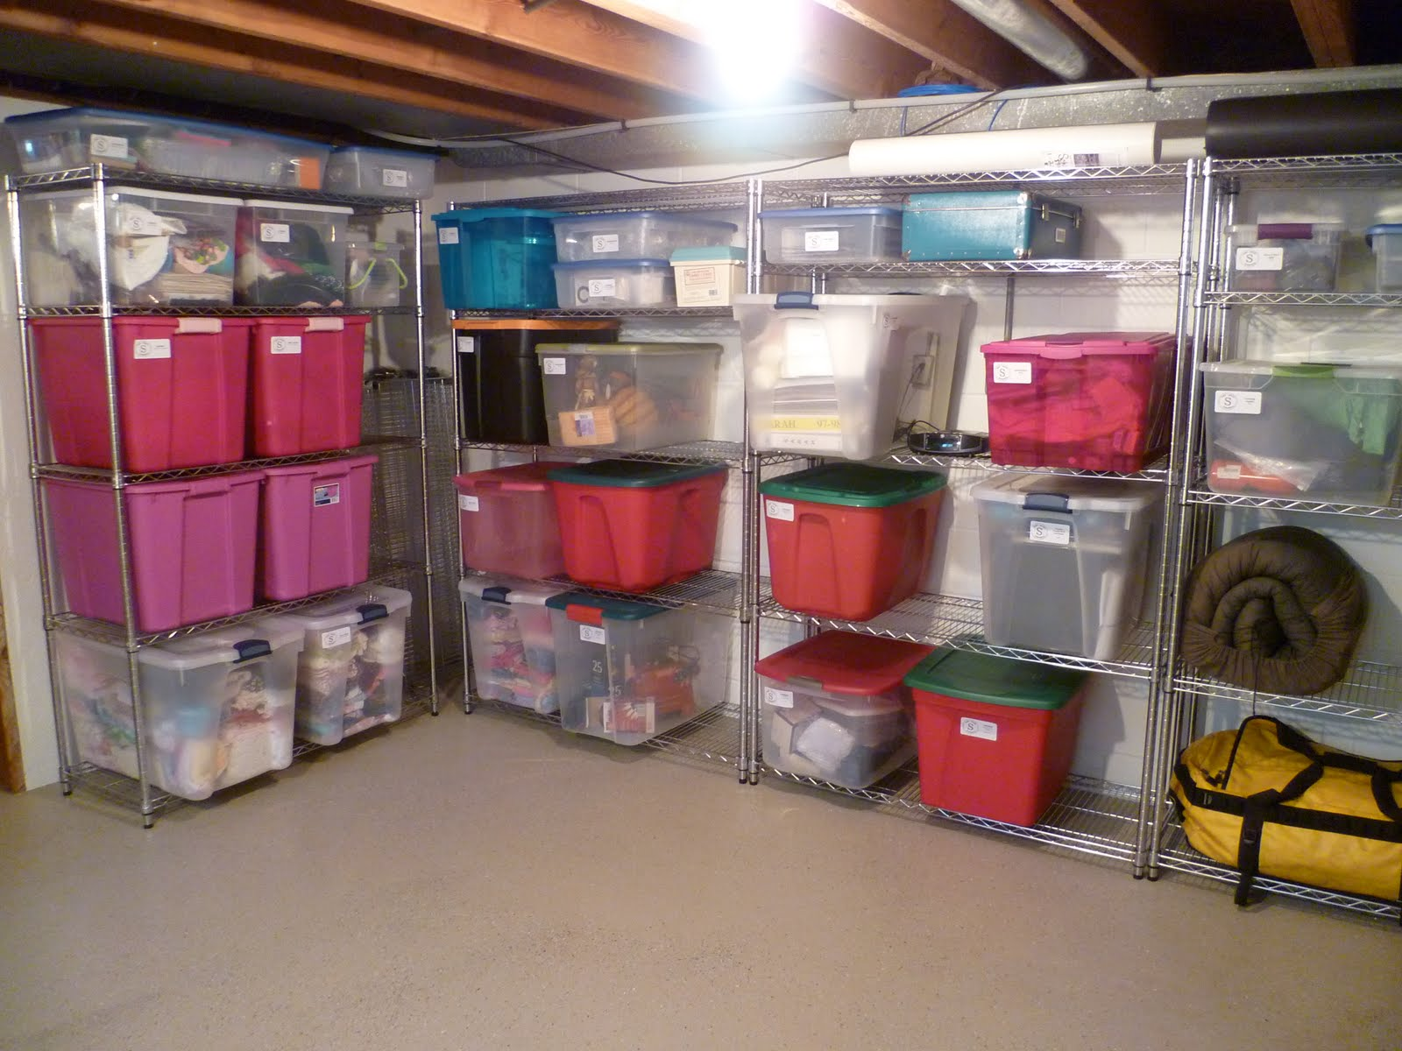
Variables and Memory
A room would be equivalent to the system resource (memory) allocated for your program
Variables are like the boxes shown in the photo:
Note the various sizes
The size of the box is determined by the type of the data
The label (name) on the box identifies the specific data being held

Slide 15
If you’re curious…
Type | Size | Example
Byte | 8 bits | ‘a’
Short | 16 bits | 32
Int | 32 bits | 1,234,567,890
Long | 64 bits | 7,223,372,036,854,755,808
Float | 32 bits | 102,378.425
Bool | 8 bits | True / False
String | Varies | “The cat in the hat fights back”

Slide 16
How to Create (Declare) Variables
This statement is called a variable declaration
Here, you are asking the computer to set aside a place in memory where you can store your age
Note that int is a datatype
myAge is a variable name (formally called an identifier)
Choose names that are easy to remember or identify
Computers do not care what names you pick as long as each is unique
namespace MyFirstProgram { class Program { static void Main(string[] args) {
int myAge;
} } }
Notes:
C# is a strongly typed language so datatypes are important. The datatype chosen will help the CLR determine the correct memory size for the variable. The int datatype is one of many datatypes available in C#. It stands for a 32-bit integer.
You only need to declare a variable once.

Slide 17
How To Assign Values to Variables
The assignment operator: =
The right-hand value will be assigned to the variable identified on the left
There can only be one right hand value
Examples:
a = 3; // 3 is an integer literal
a = b = c = 10; //10 is assigned to c. Then c is assigned to b, finally b is assigned to a (a, b and c all have the value 10 when done)
myAge = 35
myAge
Is assigned the value
35
myAge = -145
myAge
Is assigned the value
-145
Notes:
Explain about operators such as mathematical operators that tells us and computers what to do when we see a specific operator. For computers, the assignment operator means to assign a value on the right hand side to the variable on the left hand side.
You can assign any value to myAge. myAge = 145; myAge = -17; myAge=1567;
= is assignment

Slide 18
When = doesn’t mean =
The use of the = sign is a little different in programming
As an example, let’s use the statement: int theYear = 2019;
Most people read that as “theYear is equal to 2019”
They are wrong!!
The correct way to read that is
“the value 2019 is assigned to theYear” or
“the value 2019 is saved in theYear”

Slide 19
Code In Action
int number;
// Create a storage “box” (variable) that // can hold an integer (whole number). // Associate that “box” with the name number
number
int

Slide 20

Code In Action
55
int number;
number = 55;
// number is assigned the value 55
number
55
int

Slide 21
Code In Action
-4157
int number;
number = 55;
// number is assigned the value 55
Number = -4157
// the value 55 is replaced with the // value -4157
number
55
-4157
int

Slide 22
Code In Action
2337
int number;
number = 55;
// number is assigned the value 55
number = -4157
// the value 55 is replaced with the // value -4157
number = 2337
// the value -4157 is replaced with the value 2337
number
-4157
2337
int

Slide 23
Declare and assign a value to a variable
203
You can do both in one line of code (LOC)
Example: int aNumber = 203;
How the computer reads this line
int aNumber instructs the program to create a box (reserve memory)
Assigns the value 203 to aNumber
aNumber
203
int

Slide 24
Retrieving a Value from a Variable
You can simply use the name of a variable to retrieve its value
The computer will locate the variable you asked for
It will check the variable and see what value it contains
Makes a copy of that value and uses it where it’s needed
Using the Console.WriteLine() command you learned during the last class, we can do this:
int aNumber = 24; Console.WriteLine(aNumber); //displays 24

Slide 25
Retrieving a Value from a Variable – II
Another example to access the value of a variable
int number1 = 5; int number2 = 16; number1 = number2; //assigns value of number2 number2 = -45; Console.WriteLine(number1); Console.WriteLine(number2);
What will be displayed?

Slide 26
Int and String
int is a data type to store whole numbers
32-bit number
Does not store floating point number (different data type)
string is another data type – it is very different from other types
Stores text of any length
Must assign values using quotation marks: “A value”
A string holding a number (for example, “325”) cannot be used like a number

Slide 27
String examples
string name = “Professor”; string secret = “ knows all things.”; string message = name + secret; Console.WriteLine(message);
//Displays “Professor knows all things”
When using strings, the + symbol has a new meaning: concatenation (append)
Notice how the string secret starts with a space.
What would happen if the space wasn’t there?

Slide 28
String examples
string number1 = “145”; string number2 = “23”; string cat = number1 + number2; Console.WriteLine(cat);
// Displays “14523”
Why does this happen?
What would the output be if these were two int values?
What if number1 is a string and number2 is an int?
Notes:
First question: Answer 168
Second question: “14523” Because the first is a string, C#/.Net Core will convert the int value to a string

Slide 29
Coding Standards
Every organization has them
You must assume others will use, change, and update your code
Maintenance is the largest cost related to a program – so making code easy to understand is critical to your success
Bonus: You will be able to read and understand your own programs better!
Notes:
Whitespace, as well as other aspects of programming style, as required in this course, is described in our coding standard. Review it thoroughly in this lecture!
This is the time to hand out and review the I.T. Department’s coding standard. Conformance to a programming standard will be required when the student goes out into industry. Emphasize the genuine importance of good style which affords readability of one’s code by others that follow in a maintenance role. “The documentation and readability is just as, if not more, important than the code itself!”

